Slide 1
ESM and Receiver Overview
Module 2

Slide 2
Module Objectives
Upon completion of this module, you will be able to:
List and configure the main ESM system properties and communication settings.
Navigate and configure the ESM software updates, rule updates, and system backup settings.
Perform user and group management for the McAfee SIEM.
List and configure the main Receiver system properties and communication settings.
Navigate and configure vulnerability assessment and asset sources to provide additional context data feeds for the McAfee SIEM solution.

Slide 3

Module Topics
McAfee Enterprise Security Manager (ESM)
System Properties and Information
Configuration Options and Settings
Software Updates
Backups
User and Group Administration
System Logs
Login Security
McAfee Receiver
Properties and Information
Configuration Options and Settings
Vulnerability Assessment
Asset Sources

Slide 4
McAfee Enterprise Security Manager
Effective Security starts with Holistic Real-Time Visibility into all activities on all Systems
Real-Time Situational Awareness
A Complete Picture of Security Activity
Threat Management and Prioritization
Correlation of Security Events to Business Processes and Policies
Active Response and Mitigations
Consolidated Audit and Compliance Activities
Central point of administration for data, settings, and configuration
Allows SIEM administrators to keep all configuration settings, user and access group profiles, and event and flow data in a single location
Notes:
Today information security threats are increasing rapidly in not only numbers but in severity as well. Adding these increased threats with the fact that our networked environments are increasing exponentially in both diversity and complexity a holistic real-time visibility into all activities of all systems is needed more than ever. It is not only extremely important, but now a must have capability to collect and correlate the different activities happening on our critical networks. This type of information is mandatory requirement for being able to identify, prioritize, and respond to cyber attacks, policy breaches, and compliance violations. Utilizing the McAfee patented database technology to consolidate, correlate, and report on security information a holistic real-time situational awareness view can finally be achieved.

Slide 5
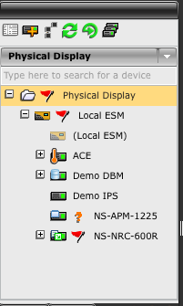
McAfee ESM Properties
ESM Properties Access
The ESM should be considered the “Brain” of the McAfee SIEM Solution providing a central Point of Control and Configuration
Notes:
The ESM is configured and managed via the System Properties dialog, which is accessed by selecting the System node (the node at the highest level on the tree) on the System Navigation Tree, then clicking on the Properties icon in the Actions Toolbar.

Slide 6
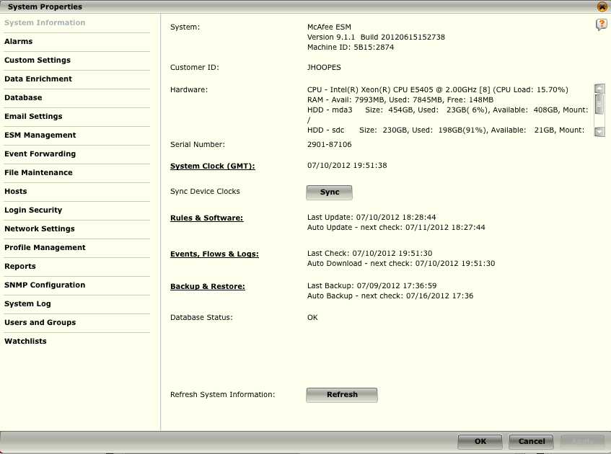
ESM System Information
The System, Customer ID, Hardware, and Serial Number fields provide status information about the ESM
The System Clock; Sync Device Clocks; Rules and Software; Events, Flows & Logs; and Backup and Restore provide quick access to these settings
The Database Status provides the current state of the ESM database
Notes:
The System Information screen contains information regarding general system-wide status.
The System, Customer ID, Hardware, and Serial Number fields provide information about the system and its current operational status.
The Database Status field shows when the database is performing other functions (e.g., a database rebuild or background rebuild) and the status of those functions. An OK status means that the database is operating normally.
The System Clock; Sync Device Clocks; Rules & Software; Events, Flows & Logs; and Backup & Restore, as well as, when in FIPS mode, FIPS Self-test and Status options can be changed, updated, enabled, or viewed from this screen. In addition, you can view and export an ESM Device Type Count report and an Event Time report.
The Refresh button allows you to refresh the data displayed on this screen
It is important to note that there is a list of properties on the left had side, but there are also clickable properties in the right frame (bolded above), as well. Text which is underlined is a link to a secondary group of settings, and buttons always reference actions.

Slide 7
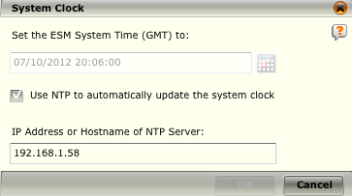
ESM System Clock
WARNING
Changing the ESM system time is a potentially dangerous operation. Choosing an incorrect time can cause incorrect event and flow data to be generated.
The System Clock dialog shows the current time on the ESM and its NTP settings, if defined.
The ESM time must be set to GMT in order to keep a constant frame of reference for data gathered from the devices.
Notes:
To set the ESM time to GMT, follow the steps below.
Access the System Information screen by clicking on the System node in the System Navigation Tree and on the Properties icon in the Actions Toolbar.
Click on System Clock (GMT) on the System Information dialog. The System Clock dialog will open.
To synchronize the ESM's time with a NTP server, click on the Use NTP to automatically update the system clock checkbox.
Enter the NTP server’s IP address or hostname in the field provided.
Click OK to save your settings.

Slide 8
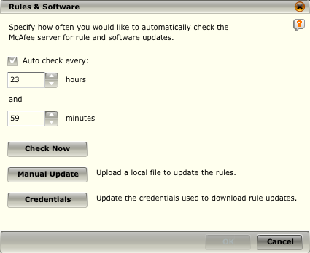
ESM Rules & Software
These settings determine how often the ESM will check for new rules and software updates.
The ESM will communicate with the McAfee servers to check for new rules and software updates.
This can be done manually, or automatically based on local policies.
Auto check – Enable to automatically check for updates
Check Now – Check the server for new rules immediately
Manual Update – Upload a local rules file or update to the ESM for a manual update
Notes:
Retrieving Rule Updates Automatically
To automatically retrieve rule updates at a specified interval:
Access the System Information screen by clicking on the System node in the System Navigation Tree and on the Properties icon in the Actions Toolbar.
Click on Rules & Software. The Rules & Software dialog opens.
Click on the Auto check every checkbox. If you have not already registered with the rules server, the Customer Validation dialog will open. If you have already registered with the rules server, skip Step 4.
Enter your customer ID and password and click on Validate.
Select the frequency with which you want the update checks to take place. By default, the system is set to check for updates every hour.
Click OK to save your settings.
Retrieving Rule Updates Manually
To manually retrieve rules and software updates:
Access the System Information screen by clicking on the System node in the System Navigation Tree and on the Properties icon in the Actions Toolbar.
Click on Rules & Software. The Rules & Software dialog opens.
Click on the Check Now button. If you have not already registered with the rules server, a Customer Validation dialog will open. If you have already registered with the rules server, go to step 7.
On the Customer Validation dialog, enter your customer ID and password, as requested.
Click Validate. A dialog will open listing all available software updates.
Choose the software update to download.
The Rule & Software Progress dialog will appear. This dialog will allow you to view the progress of the update. When finished, click OK to exit.

Slide 9
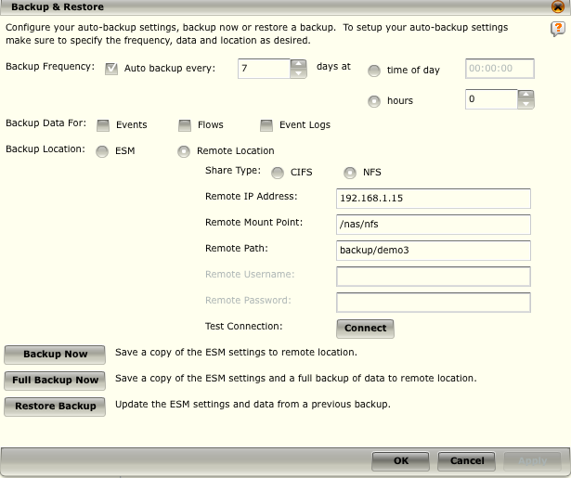
ESM Backup and Restore
NOTE
The first backup of event, flow, and/or log data will only back up data from the start of the current day.
Subsequent ones will back up data starting at the time of the last backup.
Allows you to save current system settings so they can be restored in case of system failure or data loss
It is optional to backup event, flow, and log data, but the system settings will always be backed up.
You can select to have it done automatically or manually.
Notes:
Automatically Backup System Settings
To set up the system to back up settings automatically, do the following:
Access the System Information screen by clicking on the System node in the System Navigation Tree and on the Properties icon in the Actions Toolbar.
Click on Backup & Restore. The Backup & Restore dialog opens.
Click on the Auto backup every checkbox.
Select the interval at which you want the system to backup the settings. This causes the ESM to automatically backup the settings at the specified interval.
Click Apply to save your settings and remain on the Backup & Restore screen or OK to save your settings and close the screen.
Manually Backup System Settings and Data
To manually backup the system settings:
Access the System Information screen by clicking on the System node in the System Navigation Tree and on the Properties icon in the Actions Toolbar.
Click on Backup & Restore. The Backup & Restore dialog opens.
From here, you can either manually backup the ESM settings alone or backup a copy of the ESM settings and the data on the system.

Slide 10
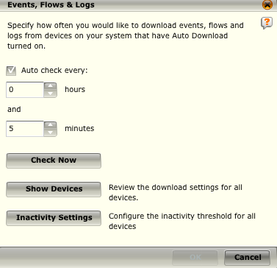
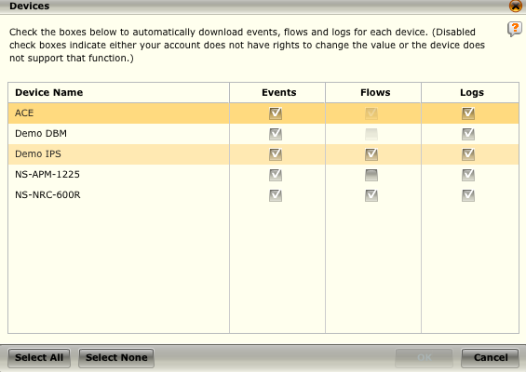
ESM Events, Flows & Logs
NOTE
You can also use the Get Events and Flows Icon to check for Events and Flows at any time
Notes:
The ESM can be configured to automatically retrieve event, flow, and log data collected from Receivers, and event and log data collected from the DEM, ACE, DESM, ELM, and ADM devices.
Automatically Check Events, Flows, and Logs
To set up the system to automatically check for events, flows, and logs:
Access the System Information screen by clicking on the System node in the System Navigation Tree and on the Properties icon in the Actions Toolbar.
Click on Events, Flows & Logs. The Events, Flows & Logs dialog opens.
Click on the Auto check every checkbox.
Select the interval at which you want the events, flows, and logs to be retrieved. This will cause the ESM to automatically check the devices for events, flows, and logs. Each device also has its individual auto-retrieval settings enabled.
Click OK to save your settings.
Manually Check Events, Flows, and Logs
To manually check events, flows, and logs:
Access the System Information screen by clicking on the System node in the System Navigation Tree and on the Properties icon in the Actions Toolbar.
Click on Events, Flows & Logs. The Events, Flows & Logs dialog opens.
Click on the Check Now button. A dialog will appear showing the status of the check. When the check is complete, the dialog will state Check Completed.
Click OK to exit the dialog.

Slide 11
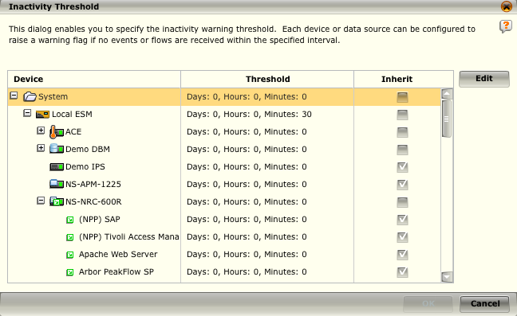
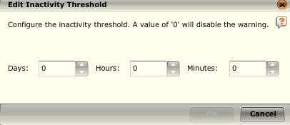
ESM Inactivity Settings
The system will generate an alert when the device has been inactive for the period of time designated
This alert will show up as a yellow flag next to the device on the System Navigation Tree
Notes:
Inactivity Threshold Settings
The Inactivity Settings button on the Events, Flows, and Logs screen (Events & Logs screen for DEM, ELM, and ADM devices; Events screen for a DESM device) allows a master user or system administrator to set the inactivity threshold for any device on the system. If this threshold is set, the system will generate an alert when the device has been inactive for the period of time designated. This alert will show up as a yellow flag next to the device on the System Navigation Tree. To use this feature, do the following:
Click on the Inactivity Settings button located at the bottom of each of the following screens:
System Properties > Events, Flows, and Logs
Device Properties > Events, Flows, and Logs
Receiver Properties > Events, Flows, and Logs
ADM Properties > Events & Logs
ELM Properties > Events & Logs
DEM Properties > Events & Logs.
The Inactivity Threshold dialog opens. The default setting for all devices is 0.
Highlight the device for which you want to set a threshold and click on Edit. The Edit Inactivity Threshold dialog opens.
Set the maximum amount of time that this device can be inactive before generating an alert by clicking on the up or down arrows in the Days, Hours, and/or Minutes fields.
Click on OK. You will be returned to the Inactivity Threshold screen. The device will reflect the change in the Threshold column, as will any "child" of the device that has the Inherit checkbox selected.
Continued on next page

Slide 12
Hidden
Notes:
By default, all devices, data sources, and database servers inherit the threshold set for their "parent." If you want to break this inheritance for a specific "child":
Deselect the checkbox in the Inherit column for the child. The Edit Inactivity Threshold dialog will open.
Set the new threshold for the child.
Click on OK.
Click on OK on the Inactivity Threshold screen to save your settings and return to the Event, Flows, & Logs screen.

Slide 13
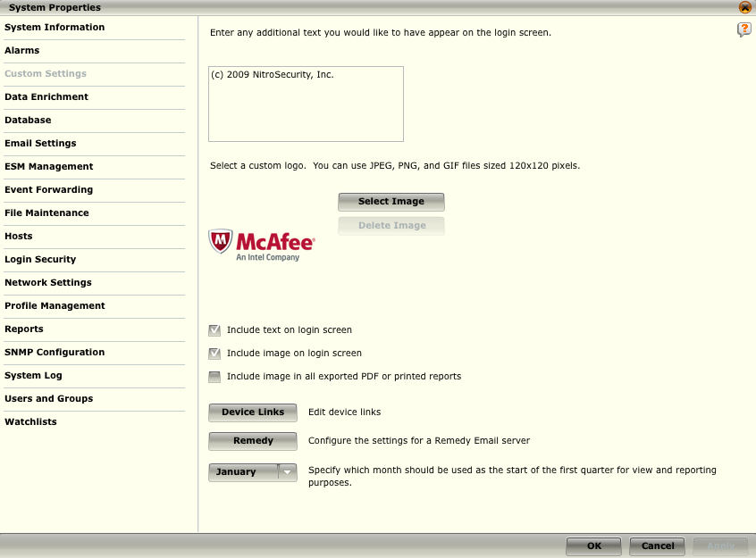
ESM Custom Settings
The Custom Settings screen allows you to customize your login and print settings, edit custom device links, and configure the settings for a remedy email server
Notes:
The Custom Settings screen allows you to customize your login and print settings, edit custom device links, and configure the settings for a remedy email server.
Login and Print Settings
You can add custom text to your login dialog, such as company security policies. You can also add a custom logo to the login screen, to printed reports, and to exported reports.
Custom Device Event Links
URL links can be defined for each device on the system to allow you to view device information. This link is accessible on the Event Analysis and Flow Analysis views for each device by clicking on the Launch Device URL icon located at the bottom of the view component.
Remedy Email Server Settings
The Remedy Configuration dialog allows you to configure the remedy settings so the ESM can communicate with your remedy system, should you have one set up.

Slide 14
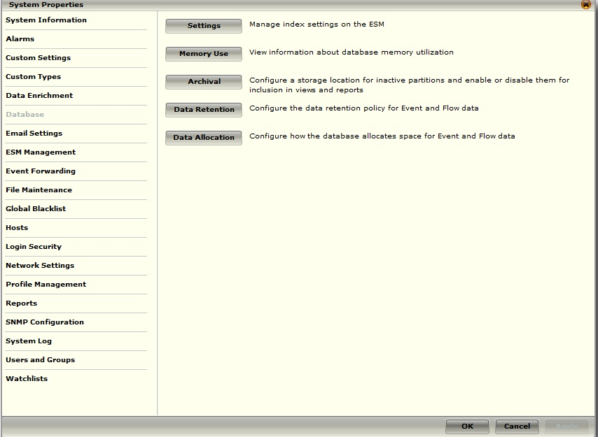
ESM Settings - Database
The Database option allows you to:
Manage database index settings on the ESM
View and print information about the database memory utilization of events and flows
Configure storage locations for inactive partitions
Configure the data retention policy for events and flows
Configure how the database allocates space for events and flows data
NOTE
Disabled or hidden options indicate either insufficient privileges or that the device does not support that function.
Also, if the key for the device was imported, there may be insufficient privileges due to specific privileges associated with the imported key.
Notes:
Settings – This allows you to change the index settings for various values related primarily to the ports which are indexed for faster searching.
Memory Use – This allows the user to view information about the memory utilization of the database.
Archival - When the storage space available for a table reaches its limit, the oldest partition is deleted. The archival feature allows you to inactivate these partitions and store them in a remote location instead of deleting them. Once the data is inactive, it is not included in queries for views and reports. The Archival feature allows you to enable or disable them one at a time as needed for inclusion in views and reports.
Data Retention - This feature allows you to select the length of time for which you would like events and flows maintained by the system as well as limit the amount of historical data inserted.
Data Allocation - The maximum number of event and flow records that can be maintained on the system is a fixed value. The Data Allocation feature allows you to set how much space should be allocated for events and how much for flows. On the high speed X5 storage device, you are also given the option to configure the number of events and the number of flows to be stored on the X5 instead of the regular hard drive.

Slide 15
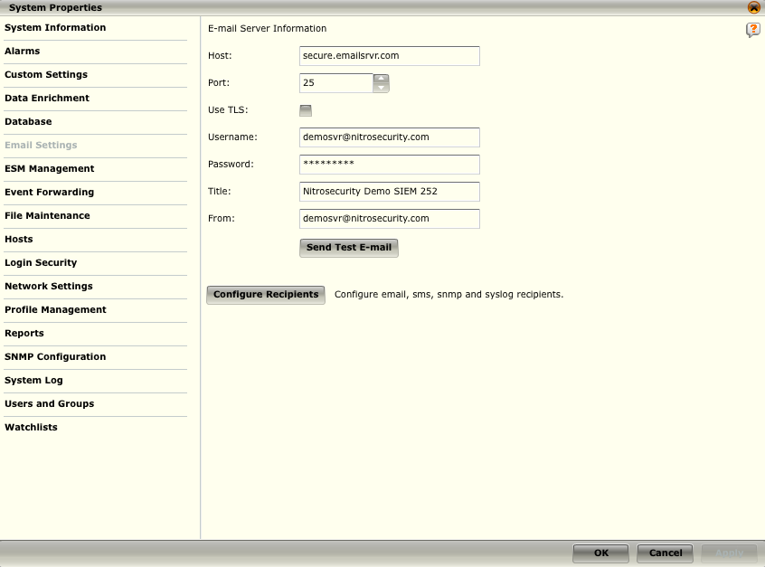
ESM Email Settings
When you are defining the action settings for an alarm, you have the option to send a message to a recipient
Once you have defined your mail server settings, you need to configure the recipients to whom you will be sending email, SMS, SNMP, or Syslog messages.
Notes:
To do so, you must first enter the information needed to connect to your mail server as follows:
Click on Email Settings on the System Properties menu. The Email Server Information dialog will open.
Enter the host and port for your email server. The default post is 25.
If you want to use the TLS encryption protocol, click on the Use TLS check box.
Enter the username (e.g., Administrator@McAfee.com) and password required to access your mail server.
In the Title field, enter a generic title for all of the email messages sent from your mail server (e.g., you might want it to be the IP address for the ESM so recipients will know which ESM is generating the message).
Enter your name in the From field.
If desired, click on the Send Test Email to test the connection.

Slide 16
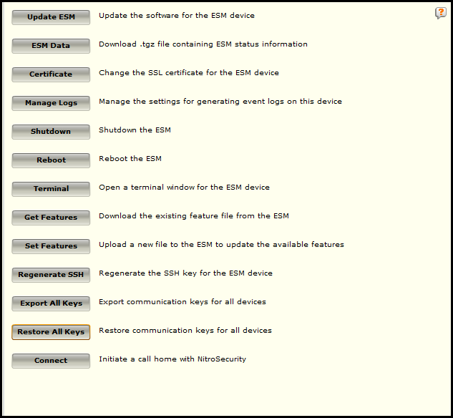
ESM Settings - Management
The ESM Management screen allows you to perform several necessary ESM management operations
NOTE
The system administrator is the only user that has access to all areas of the system, including Terminal, Certificate, Manage Logs, Get Features, and Set Features.
Notes:
Update ESM – This setting updates the ESM software version. Software updates are not downloaded and processed through the system settings updates.
ESM Data – Create an ESM status file for downloading
Certificate – Manage the SSL certificate for this device
Manage Log – Manage Log settings, which events are logged.
Shutdown / Reboot – initiate a shutdown or reboot of the ESM device
Terminal – Opens a terminal window with limited functionality
Get/Set Features – Get a list of features or set features. Used by support in advanced “hot fix” cases.
Regenerate SSH / Export Keys / Restore Keys – Options for managing the SSH keys used for device intercommunication and establishing an SSH session
Connect – Creates a secure tunnel using OpenVPN from the device to the support desk. Used by support to aid in troubleshooting and resolution of support issues.

Slide 17
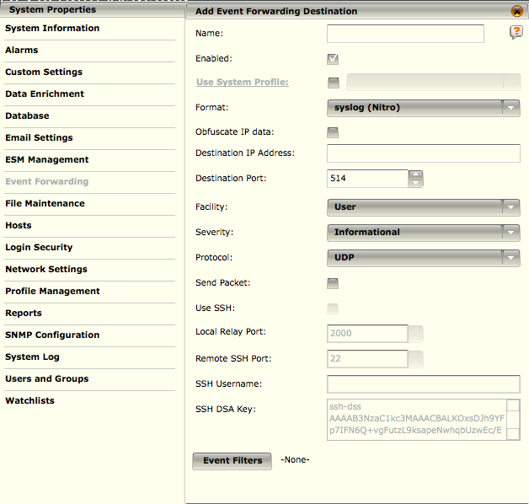
ESM Settings – Event Forwarding
Event Forwarding allows you to forward events from McAfee via either Syslog or SNMP to another device or facility.
NOTE
This is not a substitute for proper Log Management, as these will not be a full set of digitally signed logs from each device in your environment.
Notes:
In order to enable forwarding you will work with the following settings:
Use System Profiles – Allows you to use pre-defined settings for commonly used ESM settings (covered in the module about Receivers).
Event Forwarding Agent – This defines the formats, including the fields contained within the forwarded event. These fields are defined in depth and can be found by clicking the context sensitive help icon in the upper right.
Name – A name for the Event Forwarding settings
Destination IP Address / Port – The IP address and the port where the event is to be sent.
Facility / Severity / Protocol – Options for the syslog protocol.
Send Packet – If you have your policy set to copy a packet, selecting the Send Packet option will forward the packet information. This information is included, if the packet is available, at the end of the syslog message in Base 64 encoding.
SSH - If you have your policy set to copy a packet, selecting the Send Packet option will forward the packet information. This information is included, if the packet is available, at the end of the syslog message in Base 64 encoding.
Event Filters - Event filters allow you to filter the event data that is forwarded to a syslog or SNMP server on the ESM

Slide 18
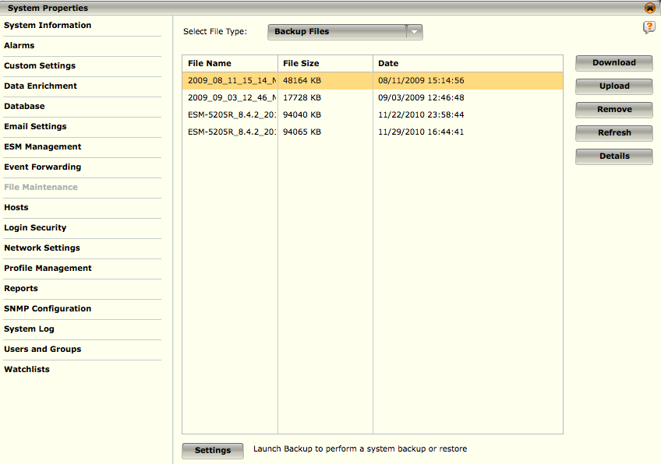
ESM Settings – File Maintenance
The Files Maintenance screen allows you to manage backup and restore, software update, alarm log, and report log files.

Slide 19
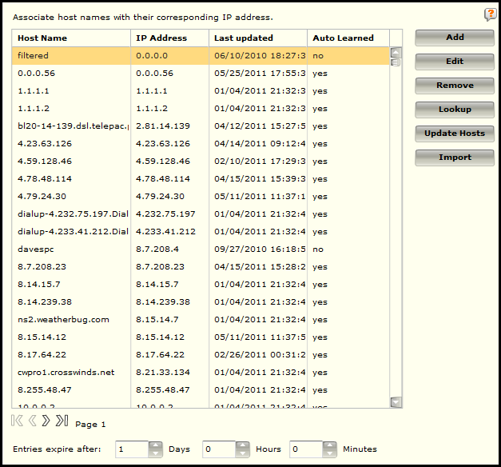
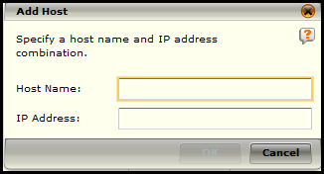
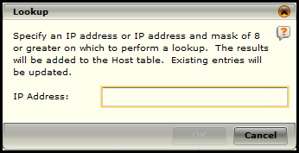
ESM Settings – Hosts
Adding hosts to the hosts table has the same effect as adding it to an /etc/hosts file in a UNIX server
Notes:
The host table will show a list of hosts that have already been auto-learned, or added via the data sources or auto discovery. This allows for name resolution in reports, dashboards and notifications, causing the system to spend less time performing DNS lookups.
To add a host:
Select the add button.
In the add host screen which appears, enter the host name and the IP Address of the host.
Hosts can be edited or removed in the same fashion.
The Lookup function allows for a host or range of hosts to be added by attempting to lookup the combination.
To perform a lookup, select the Lookup button.
Enter a single IP Address or an IP Address and a mask of 8 or greater. The system will then lookup the hosts specified and if a duplicate entry exists it will be updated.
Update Hosts will automatically refresh and update the entries when selected.
Hosts can be imported from a file using the Import action.
The format of the file is a tab delimited file with an IP followed by the hostname, and each entry is on a single line. The file needs to have a .txt extension.

Slide 20
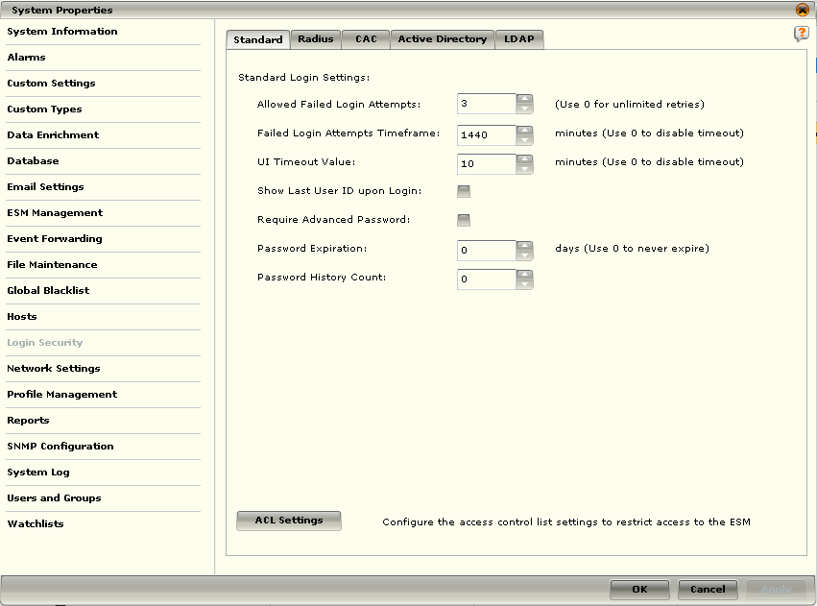
ESM Settings – Login Security
The Login Security screen allows you to define login and password, access control list, and Common Access Card (CAC) settings as well as enable RADIUS, Active Directory, and LDAP authentication
Notes:
Login Security allows you to set options for how authentication and login security is handled.
Standard – Sets standard options for locally authenticated users. (An advanced password at least 15 characters long, at least 2 numbers, at least 2 punctuation marks or symbols, at least 2 lowercase letters, and at least 2 uppercase letters.)
Radius – Enter RAIDUS server and authentication settings.
CAC – Common Access Cards which have limited, mainly government use are supported, but will not be covered.
Active Directory – Settings for AD authentication. For active directory authentication to work, a group must be created with the same name as the active directory group that needs to have access to McAfee.

Slide 21
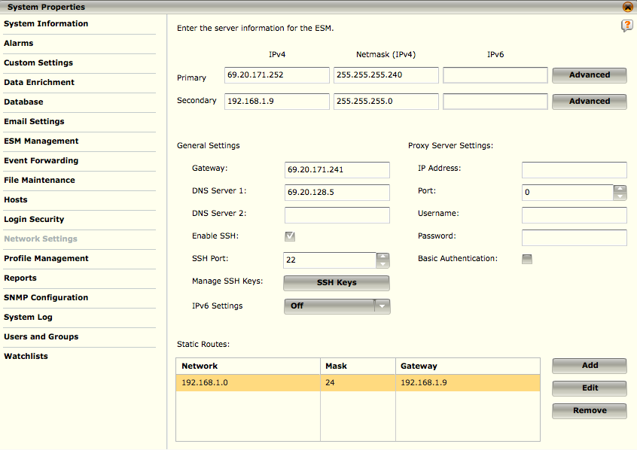
ESM Settings – Network Settings
The settings on the Network Settings screen are used to configure how the ESM connects to your network
The ESM has the ability to use two management interfaces, which allows the ESM to be used from multiple networks
Notes:
The settings on the Network Settings screen are used to configure how the ESM/ESS connects to your network. If an option is disabled, it is either not available for this device, or you have insufficient privileges to change them.
Important Notes:
At least one DNS server must be specified or the ESM will not be able to check for updates, or email reports and notifications.
If changes are made, they are pushed immediately upon clicking apply, the ESM will reinitialize, and all current sessions will be lost.

Slide 22
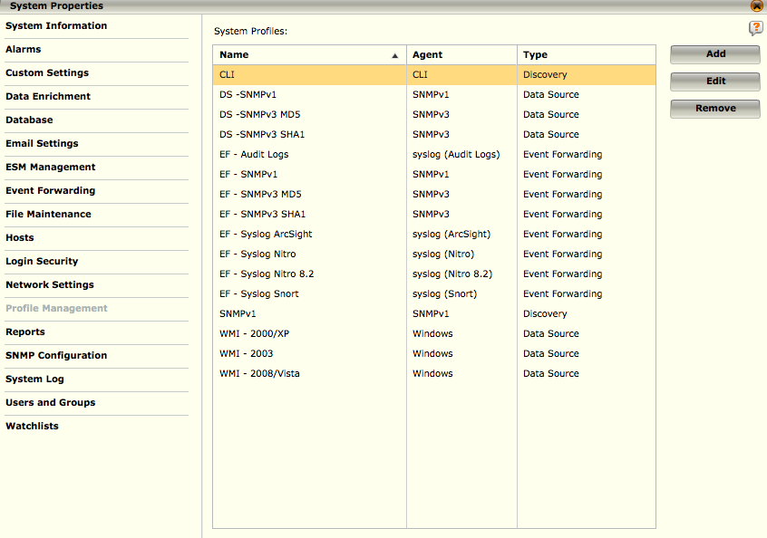
ESM Settings – Profile Management
The Profile Management option gives you the ability to configure settings for Syslog- and SNMP-based traffic that can be reused in Event Forwarding and Data Source configuration.
This allows you to perform setups that share common information without having to enter the details each time
NOTE
Disabled or hidden options indicate either insufficient privileges or that the device does not support that function.
Also, if the key for the device was imported, there may be insufficient privileges due to specific privileges associated with the imported key.
Notes:
To access Profile Management:
1.Select the System node in the System Navigation Tree.
2.Select the Properties icon in the Actions Toolbar. The System Properties dialog will open.
3.Click on the Profile Management option. The Profile Management screen opens, listing all the profiles that are currently available on the system.
From this screen you can add, edit, and remove profiles.

Slide 23
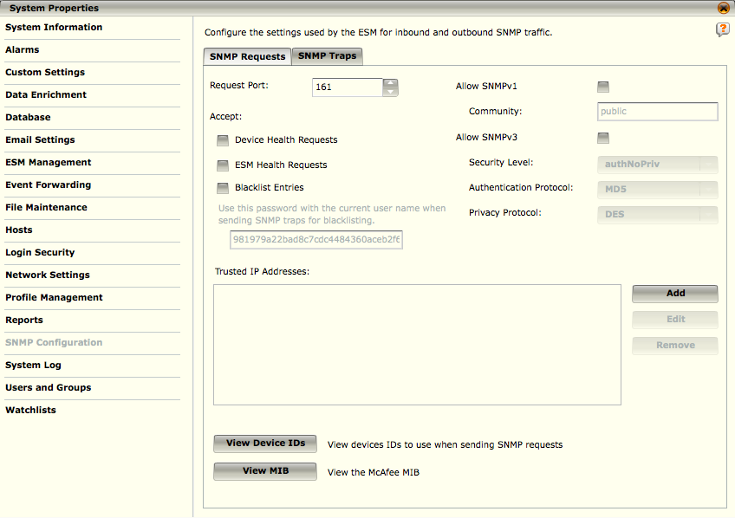
ESM Settings – SNMP Configuration
The SNMP Configuration screen allows you to configure the settings used by the ESM to send link up/down and cold/warm start traps both from the ESM and the Device, retrieve MIB-II "system" and "interface" tables, and allow discovery of the ESM via an SNMP walk
Notes:
SNMPv3 is supported with NoAuthNoPriv, AuthNoPriv, and AuthPriv options, using MD5 or SHA for authentication and DES or AES for encryption (MD5 and DES are not available in FIPS compliance mode). SNMP requests can be made to an ESM for ESM, Receiver, and IPS health information, and SNMPv3 traps can be sent to an ESM to add to the blacklist of one or more of its managed IPS devices. All McAfee appliances can also be configured to send link up/down traps and warm/cold boot traps to one or more destinations of your choosing.

Slide 24
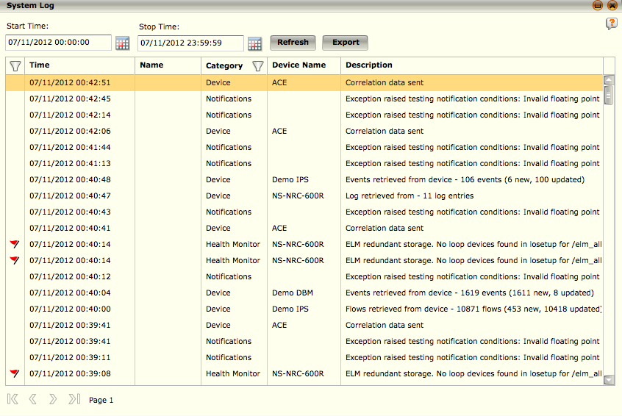
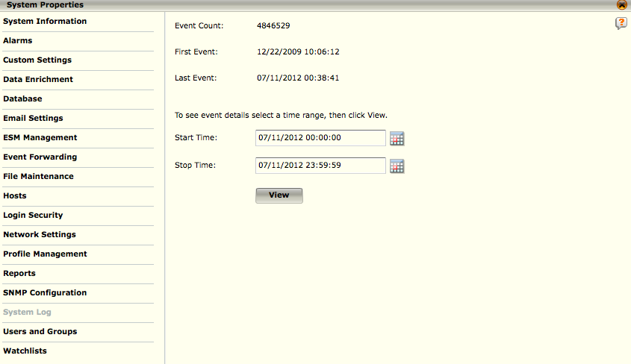
ESM Settings – System Logs
The System Log is a summary of all actions that have taken place on the devices
The System Log Preview screen gives a general summary of the events that have taken place on the ESM
Notes:
You can view the specific events on any device by selecting the System Log option at any time. The Event Count is the total number of events that have been logged on the ESM. The First Event is the date and time the first log event took place and the Last Event is the date and time the last log event took place.
To view events for a specific time range:
Select the start and end time for the range you would like to view.
Click View.
This brings up the event view, which shows the events for the selected time range
You can filter the events on a various set of criteria by selecting the filter icon, and adding the appropriate filters.
You can also export the event log to a file for further analysis.

Slide 25
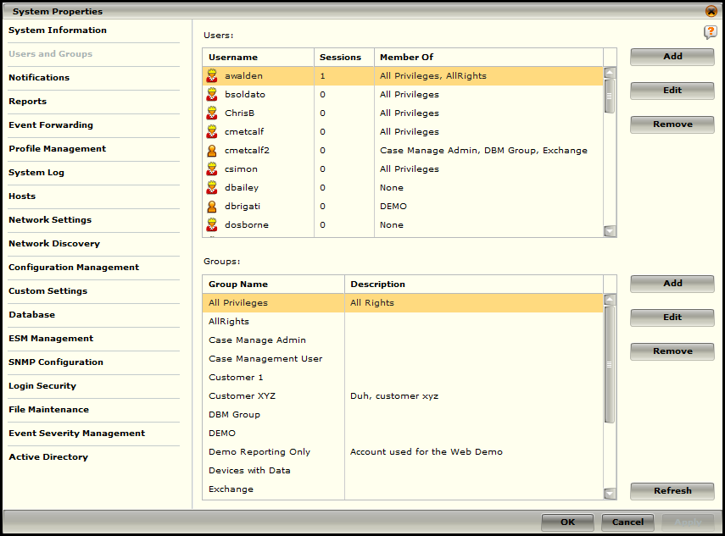
ESM Settings – Users and Groups
The ESMI has two types of user accounts:
System administrator
General user
The system administrator can grant privileges to general users by creating access groups and assigning users to these groups
NOTE
NGCP is the default username that is used to log on to all ESMs for the first time. To better secure the system, this username should be changed.
Notes:
The system administrator is the only user that has access to all areas of the system, including the Users and Groups area. Users and groups must be added to the system to have access to the ESMI, its devices, its policies, and their associated privileges.
To access the Users and Groups screen, do the following:
1. Access the System Information screen by clicking on the System node in the System Navigation Tree and on the Properties icon in the Actions Toolbar.
2. Click on Users and Groups on the System Properties screen. The Enter Password dialog appears.
3. Enter the system administrator's password and click OK. The Users and Groups dialog will open.

Slide 26
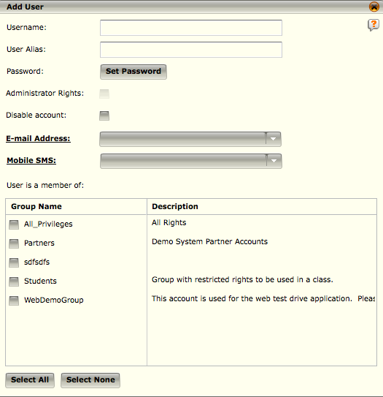
ESM Settings – Add User
Users must be added to the system by the system administrator to have access to the ESMI, its devices, its policies, and their associated privileges
Once they have been added, their settings can be edited or removed
Notes:
Once you have selected either add, or edit user, the following screen will appear. If you selected edit, the screen will be pre-populated with the user information for that user, otherwise for adding a user, the screen will be blank as above. The fields, in order are:
Username – The username assigned to the user.
User Alias – The alias (full name) of the user.
Password – Set the users initial password or reset the password of an existing user. If you selected edit user, there will be an option to delete the current password as well.
Administrator Rights – This will give the user full administrator rights for the system.
Disable Account – Disable this account, with an options once performed to re-enable later.
Email Address – The email address of the user. It will pre-populate for reports and notifications.
User is a Member of – The groups the user can be assigned to, or is assigned to. Simply select or de-select these groups to control privileges.

Slide 27
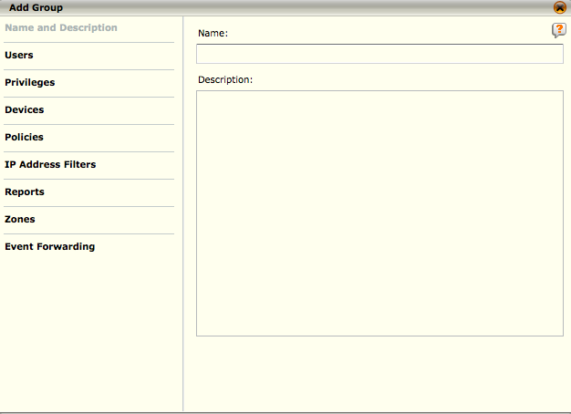
ESM Settings – Add Group
Groups contain users who inherit the privileges belonging to the group, including the right to access the devices and policies associated with the group.
When a group is added, devices, policies, and privileges must be assigned before it becomes useful.
You also have the ability to add and view IP address filters as well as add event forwarding destinations.
The Users and Groups dialog allows the system administrator to add, edit, and remove groups.
Notes:
Selecting Add or Edit Group will show the Group Policy screen where you can either modify an existing group or create a new group.
Name and Description – This is the name of the group and a brief description.
Users – A list of users that either belong to the group, or can be assigned to a new group.
IP Address Filters – These filters will limit the data that a user sees when executing reports or when a user is selected as a notification recipient.
Zones – Limits data that a user sees based on devices assigned to zones.
Devices – Controls what devices a user in this group has access to.
Notifications – Controls what notifications the users in the group can view or modify.
Reports – Controls what reports the users in the group have access to.

Slide 28
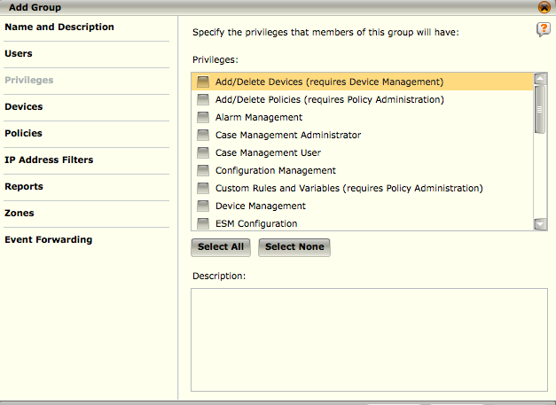
ESM Settings – Add Group
The privileges setting controls the permissions users assigned to this group have.
Some privileges require other privileges, as noted in parenthesis following the name.
To add a privilege, simply check the box, and to remove one, de-select the box.

Slide 29
McAfee Receiver

Slide 30
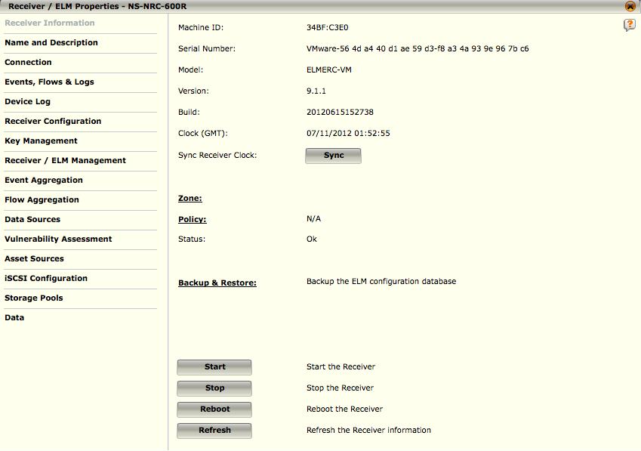
Receiver Properties
The Receiver Information screen is a general summary of Receiver information such as the machine ID, serial number, model, version of software it is running, and the status of the Receiver
Notes:
Sync - This option syncs the Receiver clock with the time of the ESM, so that both devices are using the same time.
FIPS Self Test - If the system is operating in FIPS mode, the Receiver Properties dialog will include the FIPS Self Test button. When you click on this button, the FIPS power-on self tests are run. They test the integrity of the algorithms used within the crypto-executable. If the test is successful, the Status field below will change to "FIPS OK." If the test fails, the Status field below will change to "FIPS Self test failed!." When this happens, a red flag will appear next to the device name in the system navigation tree. The FIPS self-test audit log information can viewed in the Message log.
FIPS Identity Token - The value shown below is the identity token used during the power-up software integrity testing required by FIPS 140-2.
Zone - Will show the zone to which the device has been assigned if it has been assigned to one. If you click on Zone, the Zone Policy Manager dialog will open allowing you to add zones to which you can assign devices and data sources. Refer to the Zone Management section for details.
Policy - You will see the current state of the Receiver’s policy. Clicking Policy will allow you to access the Policy Editor for this device.
Status - This field displays the status of the processes on the Receiver as well as the FIPS status after running a FIPS self test.
Continued on next page

Slide 31
Hidden
Notes:
Start - This option starts the Receiver’s flow collection, firewall, and data source feed collection. This operation has no effect if the Receiver is already operating normally.
Stop - This option stops the Receiver. It does not shut down the device but only halts the collection of data source and flow information. It is recommended that the device not be stopped except in unusual circumstances. Performing this operation will stop the flow of all traffic through the Receiver device.
Reboot - This option allows you to reboot the Receiver.
Refresh - The Refresh button will reload all the information displayed on this screen.

Slide 32
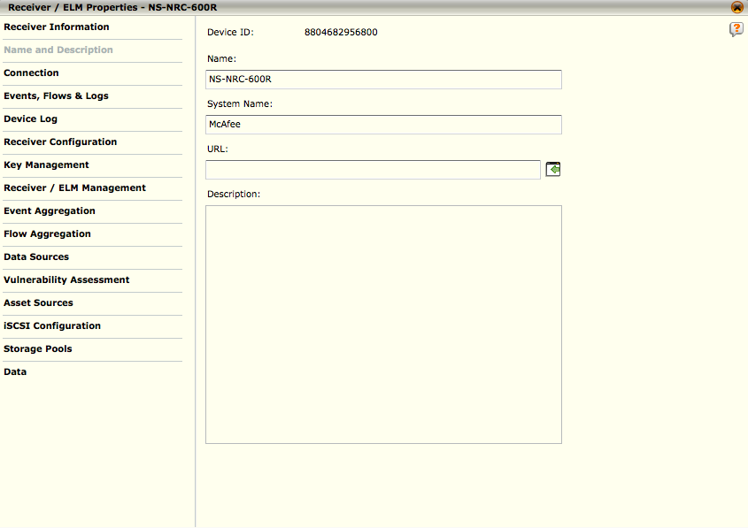
Receiver Name and Description
The Name and Description screen shows the Device ID and allows you to:
Modify the name of the current Receiver
Add or edit the system name
Add or edit a URL address where you can view event or flow information
Add a description of the device
NOTE
The system name must begin with an alpha character and can only include alphanumeric characters and dashes
Notes:
To make changes to the Name, System Name or Description fields, enter the new information then click on Apply to save changes and remain in the Properties dialog, or click OK to save the changes and close the Properties dialog.

Slide 33
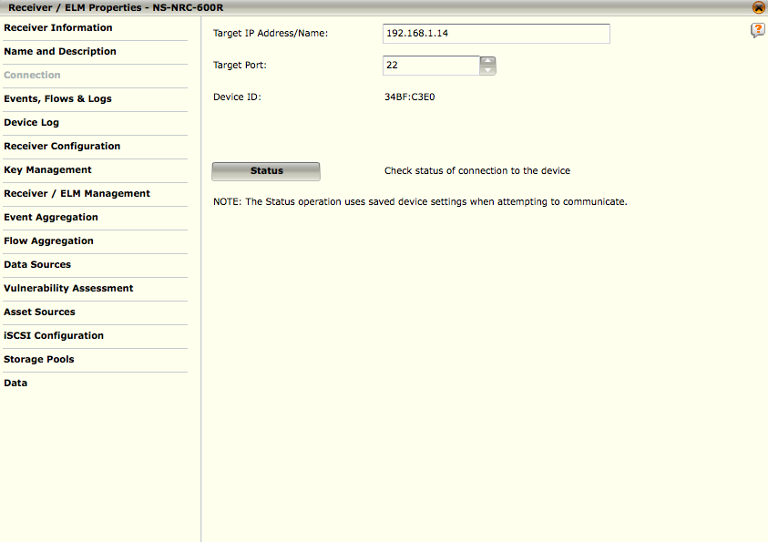
Receiver Connection
The Connection screen allows you to change how the ESM connects to the Receiver device
Changing these settings does not affect the Receiver device itself
NOTE
Disabled or hidden options indicate that the user has insufficient privileges or that the device does not support that function.
Also, if the key for the device was imported, there may be insufficient privileges due to specific privileges associated with the imported key.
Notes:
To make connection changes, follow the steps below.
1.Highlight the Receiver's node on the System Navigation Tree.
2.Click on the Properties icon in the Actions Toolbar. The Receiver Properties dialog will open.
3.Click on the Connection option on the Receiver Properties screen. The Connection dialog will open.
4.Enter the new information in the fields provided in the Connection dialog. Below is a brief description of each setting.
•Target IP Address/Name - Enter the IP address or host name that will be used when trying to communicate with the Receiver.
•Target Port - The port over which communication will be attempted. The default port is 22
•Device ID - This is a non-editable field that will display the ID for the Receiver.

Slide 34
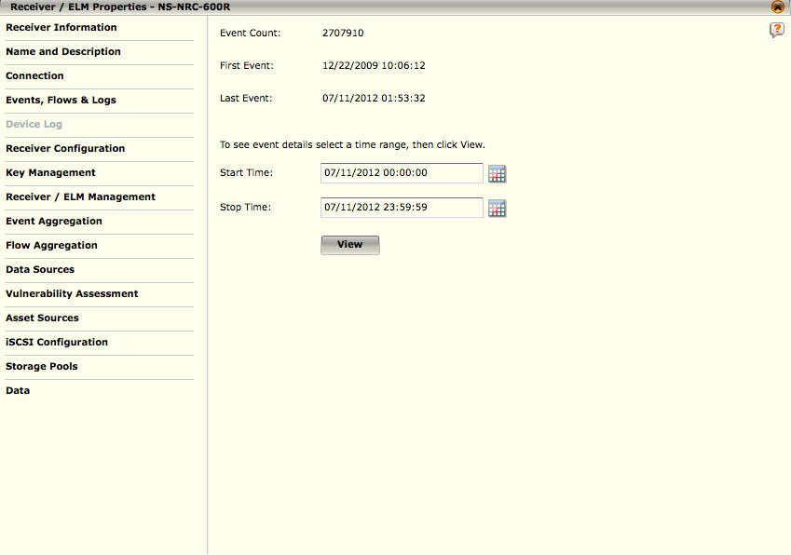
Receiver Device Log
The Device Log screen gives a general summary of changes that have been made to the device from the ESMI and status-related events that have occurred
The Event Count is the total number of events that have been logged on this Receiver
The First Event is the date and time the first log event took place
The Last Event is the date and time the last log event took place.
Notes:
To view events for a specific time range, select the date and time range of the events you wish to view, by typing in the date/time value or selecting one from the calendars, then click the View button. By default, the event log time range is set to show events for the current day. The Device Log dialog will appear, which shows a list of all the events that have taken place within the specified time range.

Slide 35
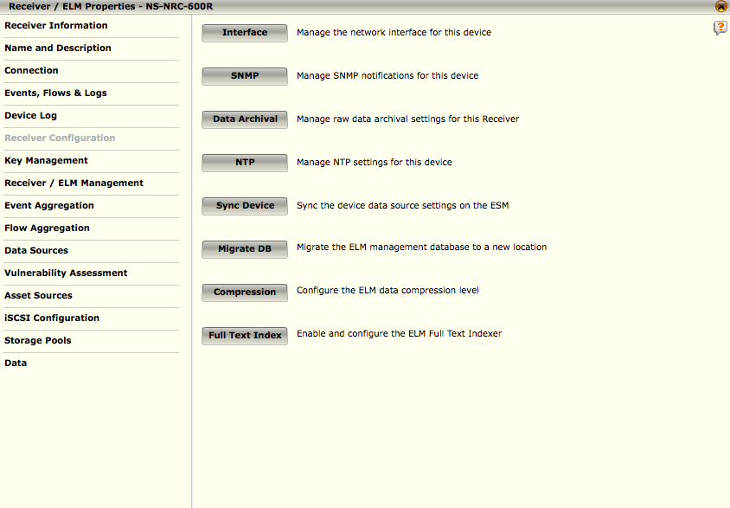
Receiver Configuration
Allows you to set up the interface on the Receiver, NTP, and Data Archival settings, along with a few of the interface settings that are retained in the ESM database.
It also allows you to sync the data sources on your ESM with those on the receiver.
Notes:
The options on this screen are explained in the following sections:
Interface – Configures how ESM and Data Sources will connect to Receiver.
SNMP – Configures SNMP notifications for the device.
Data Archival – Configures the Receiver to forward a backup of the raw data to your storage device for long-term storage.
NTP – Manage NTP settings for the device.
Sync Device – This will sync the Receiver with the data source settings on the ESM.
Migrate DB – This will migrate the ELM DB to a different location. If initiated on an in use ELM, the ELM will be available for some time until completed.
Compression – Changes the ELM compression level. Higher compression ratios result in a lower EPS for the ELM and increased search times.
Full Text Index – Indexes the ELM logs

Slide 36
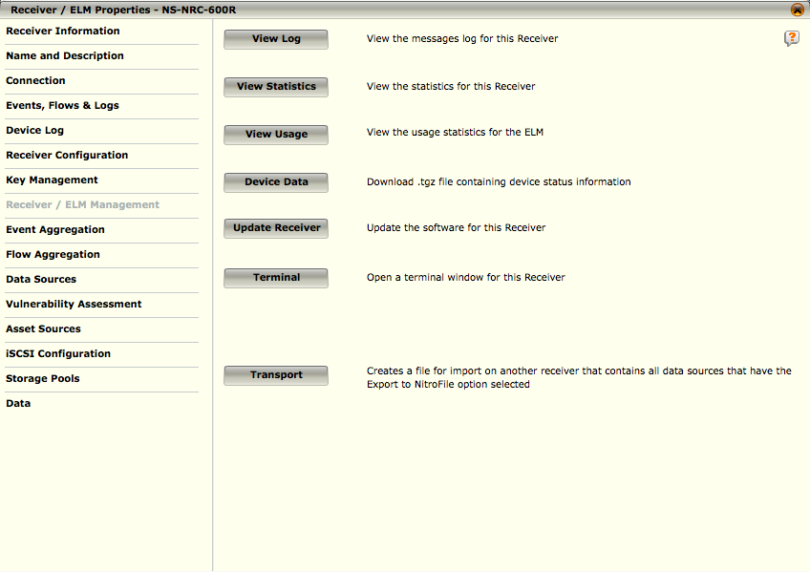
Receiver ELM/Management
Receiver Management allows you to modify or view information regarding the Receiver device
NOTE
The ELM Upgrade option is not available on all models. This option is not supported on HA Receiver pairs.
Notes:
To access this screen:
1. Select the desired Receiver on the System Navigation Tree.
2. Click on the Properties icon in the Actions Toolbar. The Receiver Properties dialog opens.
3. Select Receiver Management. The Receiver Management screen will open.

Slide 37
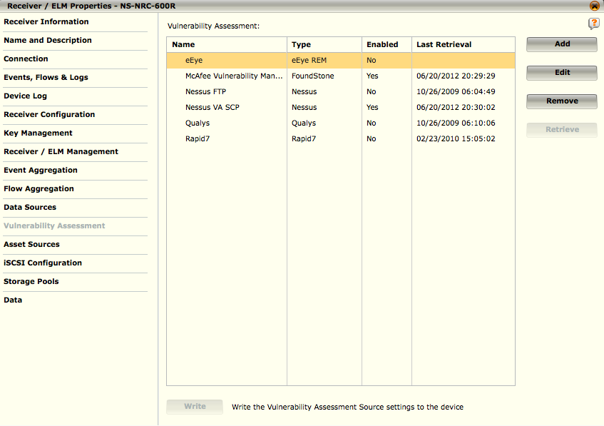
Receiver Vulnerability Assessment
This feature allows you to retrieve data from a variety of vulnerability assessment vendors.
In order to communicate with the desired VA sources, you will need to add the source to the system as well as edit it or remove it from the system when needed
Once a source has been added to the system, you can retrieve the VA data
Notes:
To add a VA source, do the following:
Access the Asset Manager screen by clicking on the Asset Manager quick launch icon ().
Click on the Vulnerability Assessment tab. A tree showing the Receivers on the system with their current VA sources, will open.
Click on the Receiver to which you want to add the VA source. The Add button will become active.
Click on Add. The Add Vulnerability Assessment Source dialog will open.
When you have filled in all the appropriate information, click OK. The VA source will be added to the table.
The settings need to be written to the devices. To do so, click on the Write button. The Writing changes to devices dialog will open. The Status column will inform you of the status of the process.
The Vulnerability Assessment tab also allows you to edit, remove, or retrieve VA sources. To do so, select the source(s) and click on the Edit, Remove, or Retrieve buttons.

Slide 38
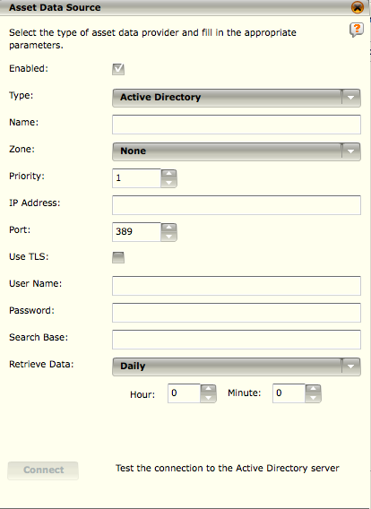
Receiver Asset Data Source
Retrieves and imports Active Directory data into the ESM
Provides filtering capabilities using Active Directory Users and Groups
Enables a simplified method for providing User compliance related data reports to Auditors
Notes:
Currently, the Asset Sources feature allows you to retrieve data from your active directory, if you have one. Once this process is completed, you can filter event data by selecting the retrieved user(s) or group(s) in the Source User and/or Destination User view query filter fields. This improves your ability to provide compliance data for requirements like PCI. Once you have added asset sources, you can edit or remove them, as well as retrieve their data manually. These functions can be performed by selecting the asset source then clicking on the Edit, Remove, or Retrieve button on the Asset Sources screen.

Slide 39
The first backup performs a backup up of all event, flow, and/or log data?
True
False
Notes:
False: The first backup of event, flow, and/or log data will only back up data from the start of the current day.

Slide 40
The McAfee ESM software and rule updates can only be applied if the ESM has an an Internet connection?
True
False
Notes:
False: The ESM can be manually updated offline with a software/rule update file.

Slide 41
The McAfee ESMI Desktop allows you to configure which types of accounts?
System Administrator
Email Administrator
General User
Receiver Administrator
Support User
Notes:
Answer: System Administrator and General User

Slide 42
Which of the following are valid system names for a McAfee ESM device?
ACME-ESM
ACME(ESM)
ACME_ESM
ACME-ESM-1
ACME-ESM@ACME
Notes:
Answer: ACME_ESM

Slide 43
Hands-on Practice Refer to the Practice Manual Practice 2: SIEM Users and Groups

